Slide 1
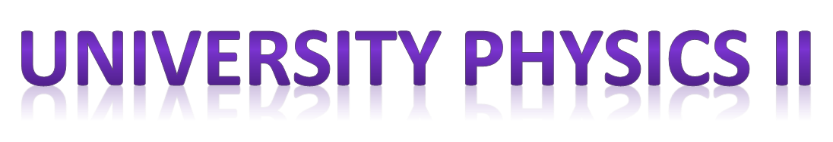
Chapter 32 – part II

Slide 2
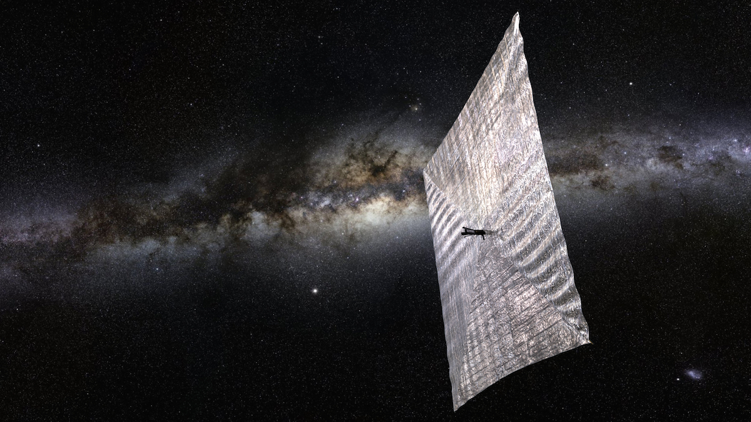
OUTLINE
  Energy and momentum in EM waves.
  Radiation pressure.
  Standing EM waves.

Slide 3
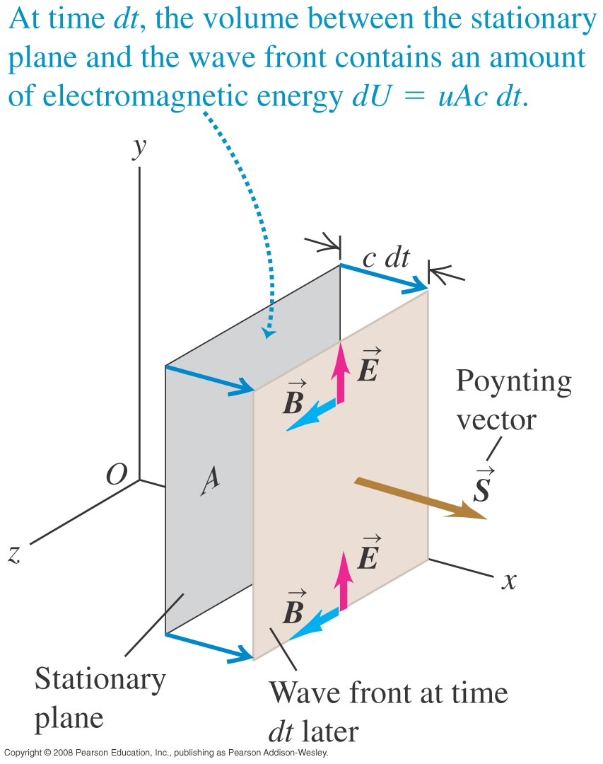
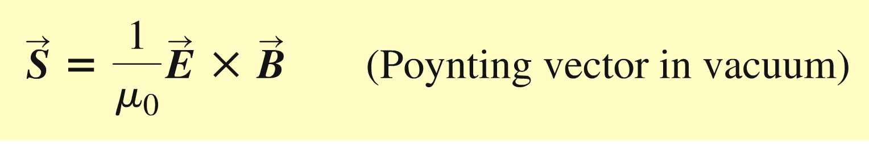
Energy in electromagnetic waves
  The magnitude of the Poynting vector is the power per unit area in the wave, and it points in the direction of propagation.
  The intensity of a sinusoidal electromagnetic wave is the time average of the Poynting vector.

Slide 4
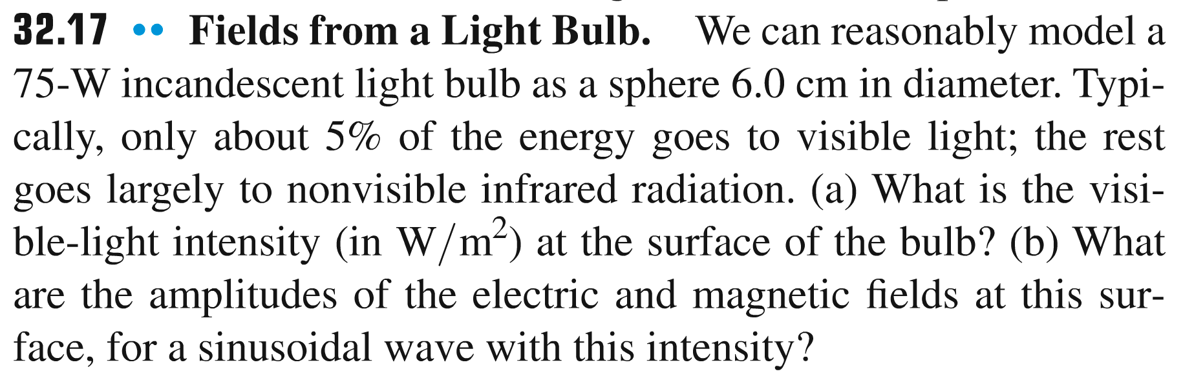
Problem #1

Slide 5
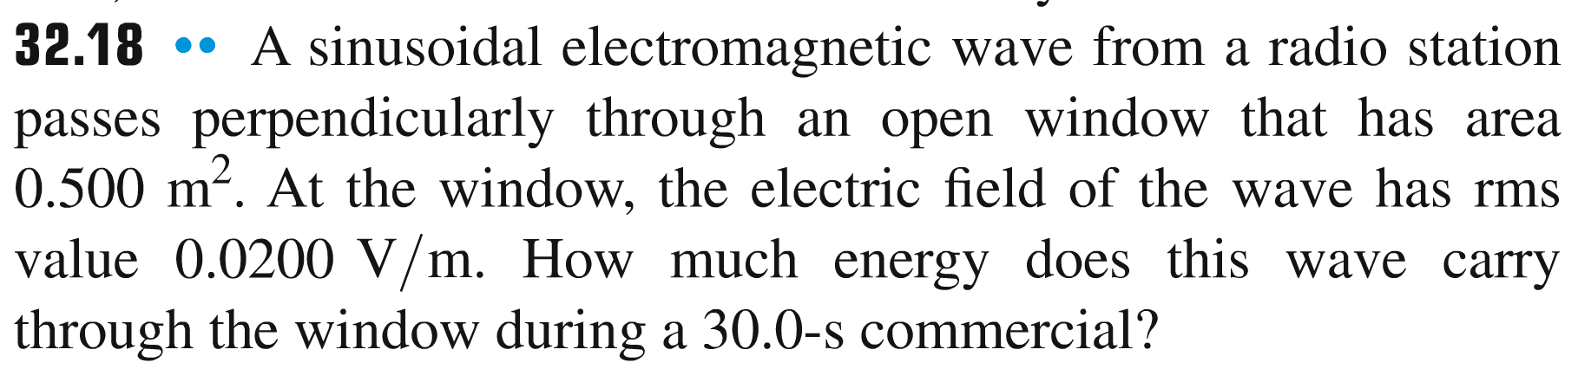
Problem #2

Slide 6
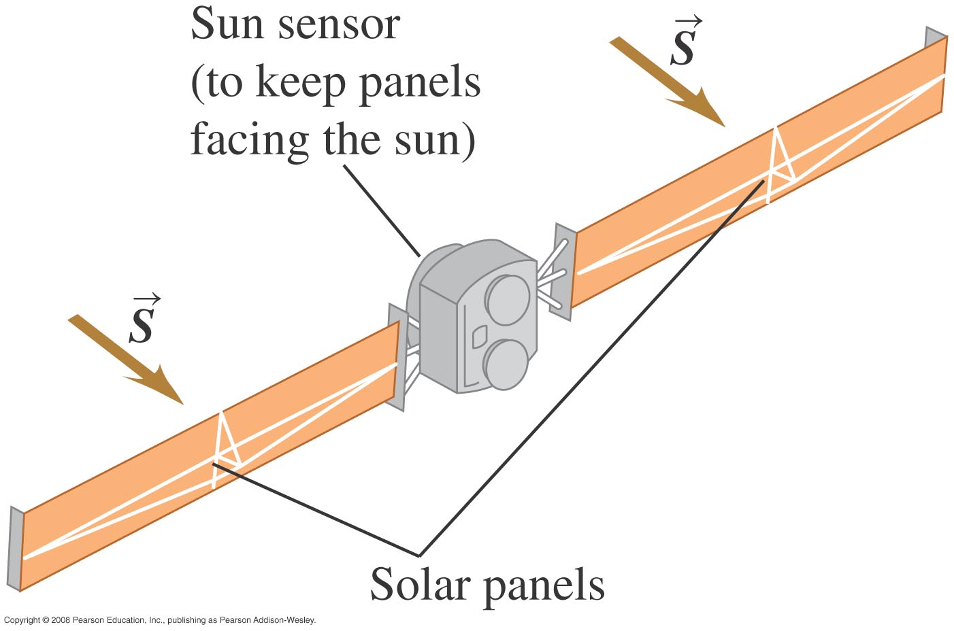
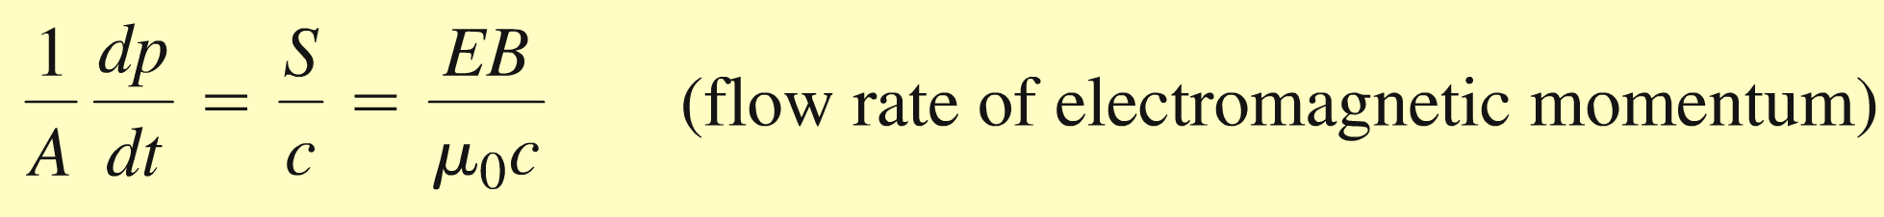
Electromagnetic momentum and radiation pressure
  Electromagnetic waves carry momentum and can therefore exert radiation pressure on a surface.

Slide 7
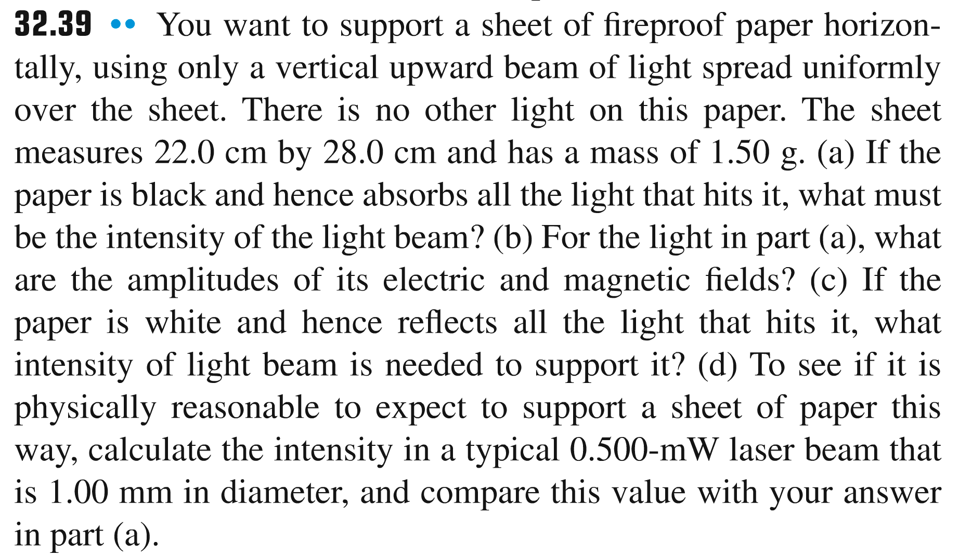
Problem #3

Slide 8
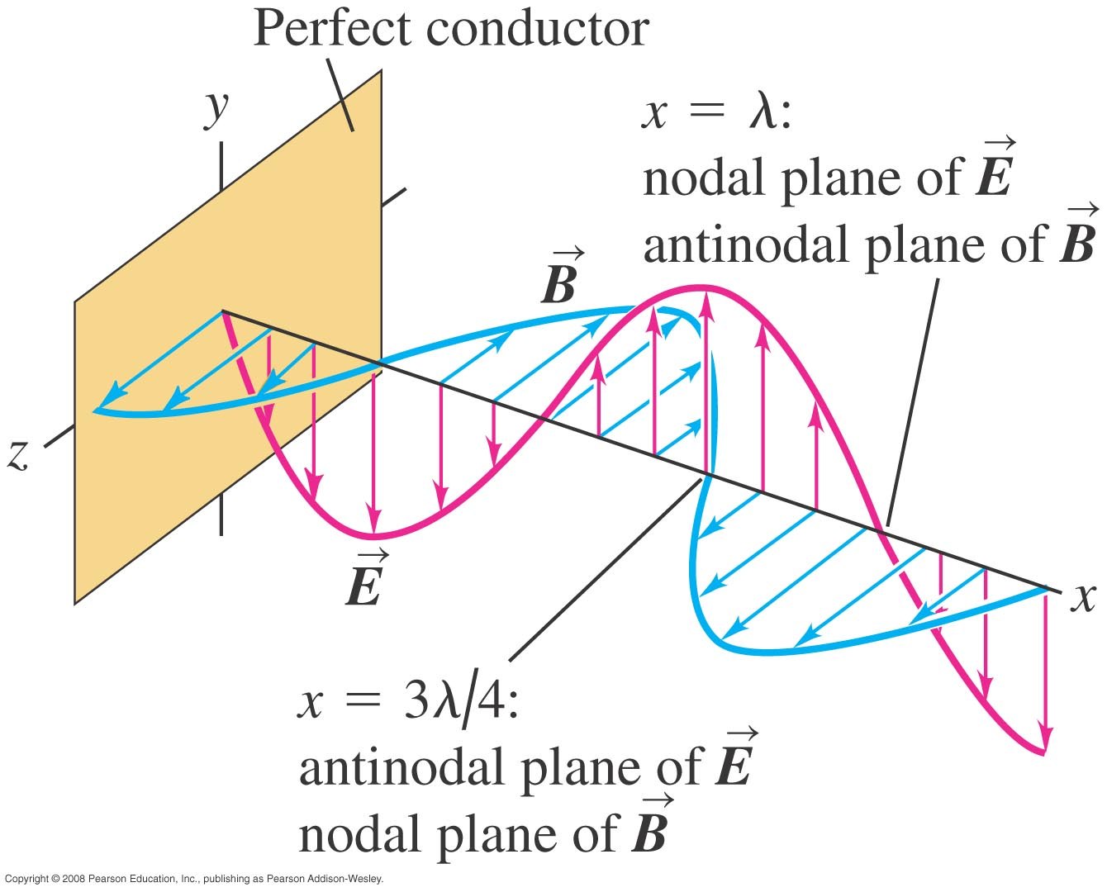
Standing electromagnetic waves
  Electromagnetic waves can be reflected by a conductor or dielectric, which can lead to standing waves.

Slide 9
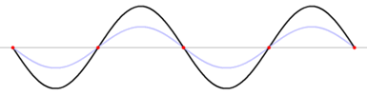
Standing electromagnetic waves

Slide 10
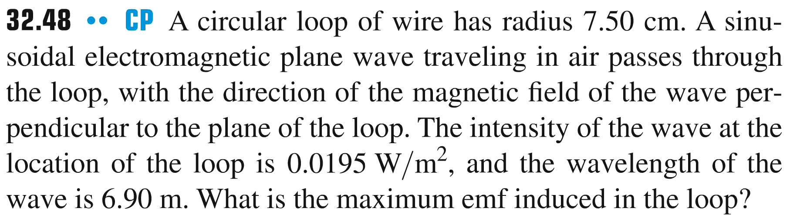
Problem #4

Slide 11
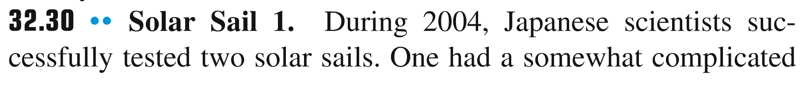
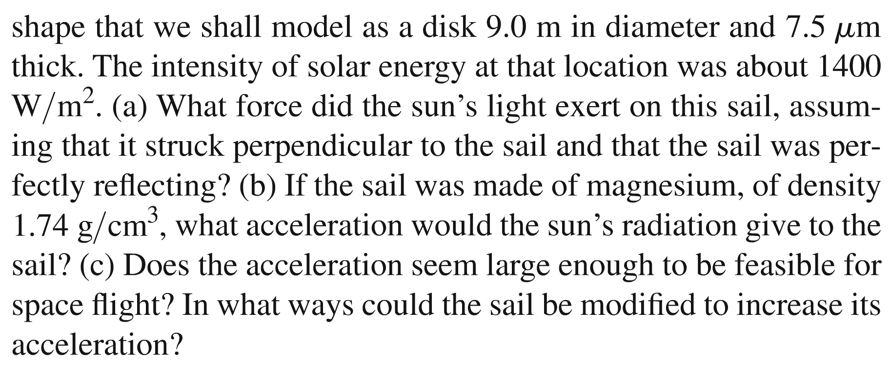
Problem #5

